Slide 1
College Management System
DataBase System Lab
Semester Project

Slide 2
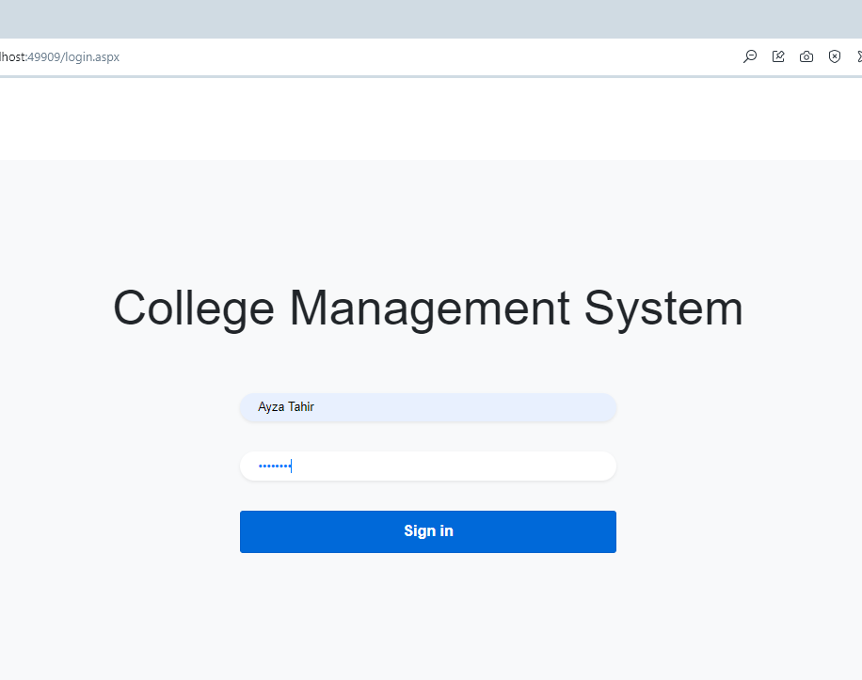
Log in Page
Only Those persons can log in into the system who enter valid credential which are store in Admin DataBase

Slide 3
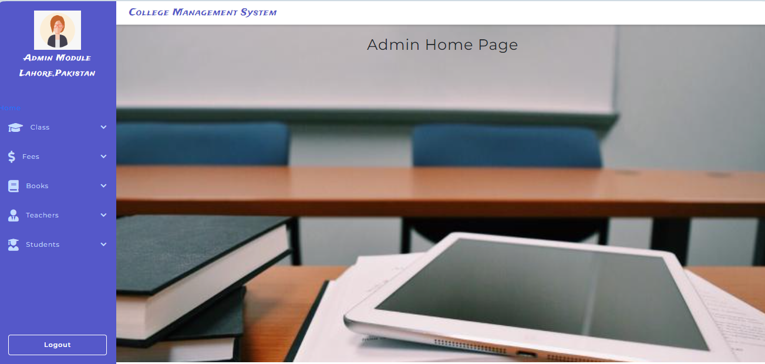
Admin Home Page
After Successful login, the First page the Admin can view is the Admin Home page where he can be able to see all the modules.

Slide 4
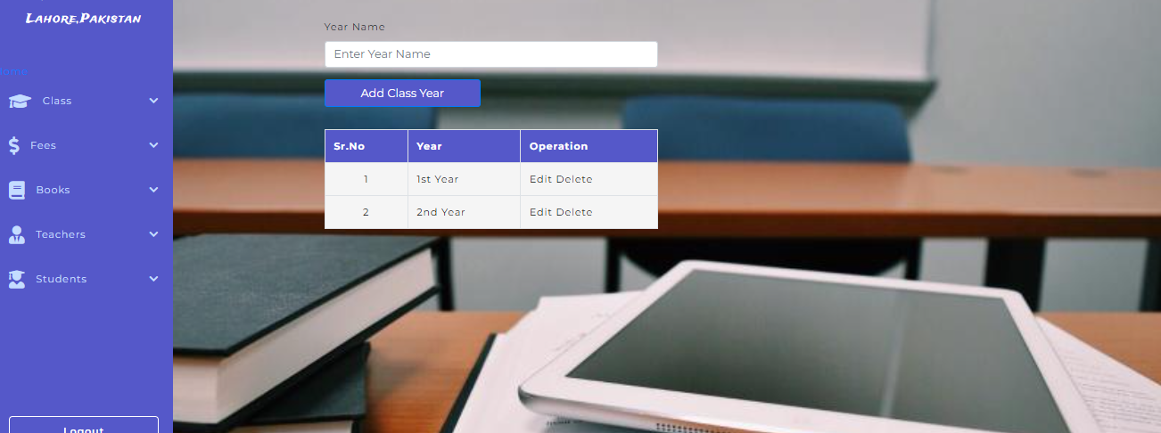
Add Class Year
In this module we can insert class name which teaches in the college and also delete and edit operations we can perform in it.

Slide 5
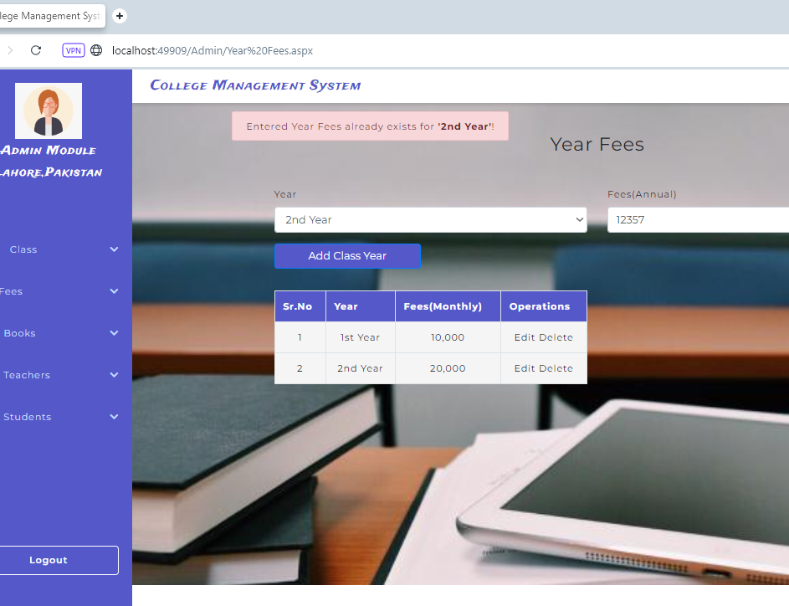
Add Fees Amount
We can delete ,edit ,inert the row. And already inserted class name cannot be inserted again but we can edit,delete the fee amount of the class.

Slide 6
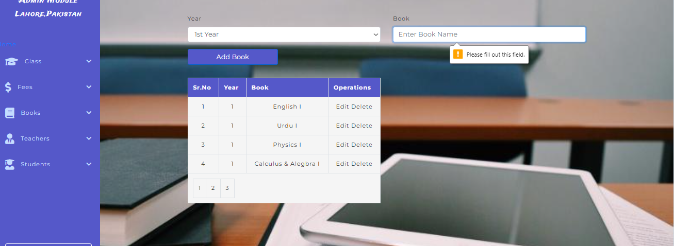
Add Books
AS you see only four rows are displaying because the page size is 4.And we can inert new book name of the class. and also we can perform edit ,delete operations.

Slide 7
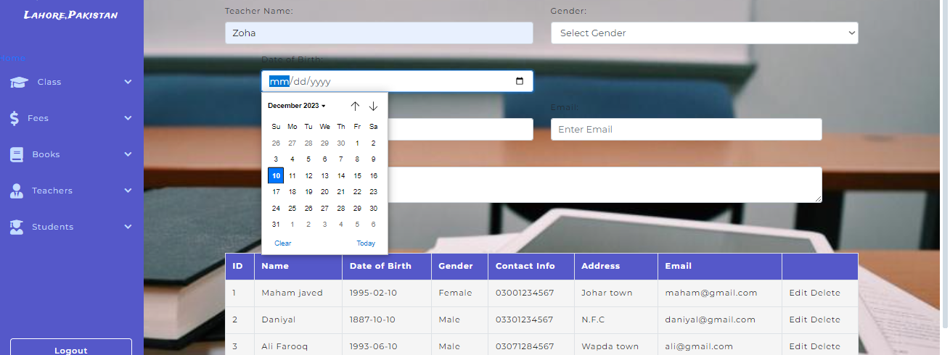
Teachers Record
We can insert, edit, delete the teacher record here.
Only those phone number can enters who is of 11 digits otherwise no insertion will occurs.

Slide 8
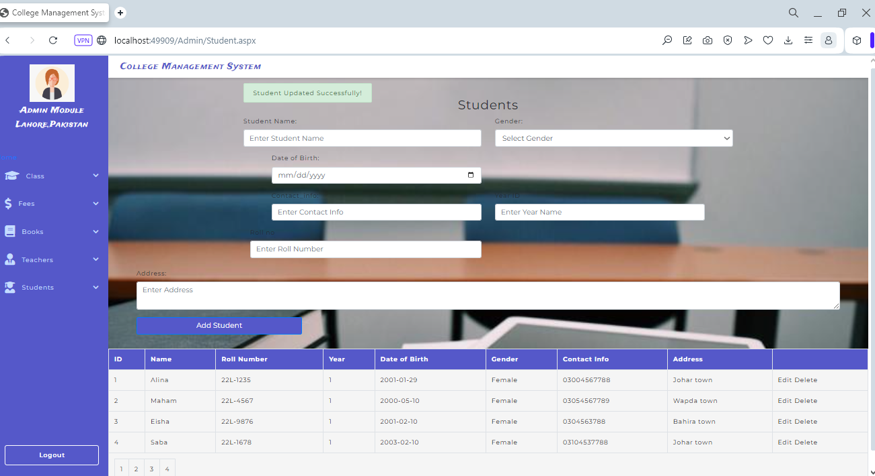
Student Record
This table is design for student Record.
Edit, inert, delete operations we can perform and success message will be also displayed on the screen.

Slide 9
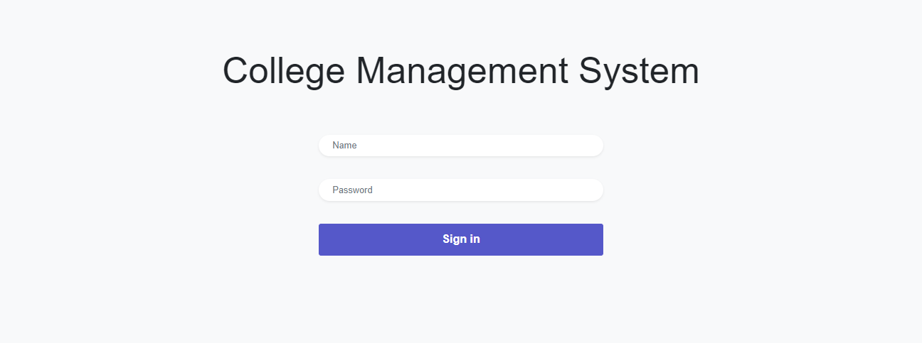
Log Out
After Logout, log in page will display.

